Slide 1
Capstone Chronicles
User Guide
-Cykie Productions

Slide 2

Controls
Use the Arrow Keys to navigate menus
The Enter Key will confirm/select options when applicable
The Escape Key will go back to the previous menu if available
Text can be sped up by pressing any key

Slide 3
The Basics
The goal is to scale Mount Daigry and touch the legendary Capstone to escape to the real world, thus beating the game.
It’s turn-based meaning you and your enemies take turns performing actions.
Your party is a team that fights alongside you. Each one can perform a different set of actions each turn. Enemies can also attack as a team.
If your party’s hit points (HP) reach zero then you lose, but if you deplete your enemy’s HP to zero then you get a reward and continue.

Slide 4
Leveling Up
Heroes gain experience (exp) after successful battles.
Different types of enemies give different amounts of exp
Once a Hero’s exp gets high enough they level up which increases each of their stats by a certain amount
When leveling up a Hero may also gain a new skill to use

Slide 5
Actor Stats
 | Description
HP | AKA hit points; The amount of damage an actor can take before they are removed from battle. It is split into Max HP and HP.
SP | AKA stamina points; Using skills drains from this stat based on their cost. It is split into Max SP and SP.
Attack | Factored into the damage algorithm for physical attacks.
Defense | Reduces damage taken.
Special | Factored into the damage algorithm for special attacks.
Speed | Used to decide turn order in battle. If one actor’s speed is greater than another, then they act before them.
Exp | For enemies this is added to the heroes exp when defeated. For heroes this determines how close they are to a level up.
Needed Exp | For heroes only; The hero will level up as long as their exp is greater than this stat.

Slide 6
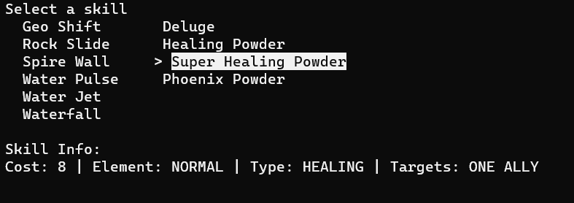
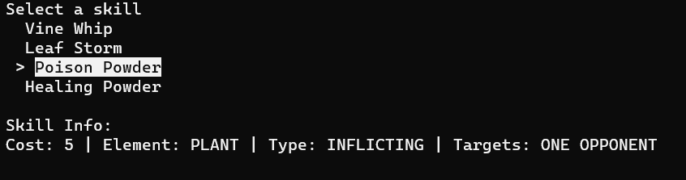
Skills and Status Effects
Skills are special actions that actors can perform on their turn.
They can deal damage, heal, or inflict status effects.
If an actor has status effects, they will be triggered before they act.
This can be dealing damage each turn or even something like scrambling who an actor is targeting.

Slide 7
Elements
Water
Fire
Plant
Attacks can have an element attached to them which makes them deal more or less damage depending on the element of their target.
Ex: a water attack does more damage against a fire-based enemy.
This can be as simple as Rock-Paper-Scissors or can be far more complex. This game falls on the more complex side (next slide).

Slide 8
Element Chart
 | Defending
Attacking |  | Normal | Fire | Water | Plant | Ground | Air | Electric
 | Normal |  |  |  |  | Resist | Null
 | Fire |  | Resist | Resist | Bonus | Resist
 | Water |  | Bonus | Resist | Resist | Bonus
 | Plant |  | Resist | Bonus |  | Bonus
 | Ground |  | Bonus |  | Resist |  | Resist | Bonus
 | Air |  | Bonus |  |  |  | Resist | Resist
 | Electric |  | Resist | Bonus |  | Null | Bonus | Resist

Slide 9




Links
GitHub Page:
https://github.com/CykieProductions/AS-Capstone-Project
Game Jolt:
https://gamejolt.com/@CykieStudios

